Slide 1


HUMAN RESOURCE MANAGEMENT SYSTEM
SEMESTER END FINAL MINI -PROJECT ( SEMESTER – III , ACADEMIC YEAR 2022-23)
ATHARVA DESHPANDE (21162171003 / CYBER SECURITY )
GANPAT UNIVERSITY - INSTITUTE OF COMPUTER TECHNOLOGY

Slide 2
CONTENTS
INTRODUCTION
MINI PROJECT ABSTRACT
TOOLS & TECHNOLOGIES USED
CODE SNIPPETS
OUTPUT SCREEN-SHOTS
CONCLUSION
BIBLIOGRAPHY (REFERENCES)

Slide 3
MINI PROJECT ABSTRACT
The Project titled “HUMAN RESOURCE MANAGEMENT SYSTEM” aims to build a compatible , user friendly featuristic software for HR and it’s team to perform daily office tasks.
It is a simple Mini Project coded in java with the help of JDBC which can perform basic CRUD (Create , Read , Update & Delete) functions.
Thus , User can Add , Update , Delete and View employee’s details.

Slide 4
INTRODUCTION
WHAT IS HUMAN RESOURCE MANAGEMENT SYSTEM ?
An HRMS, or human resources management system, is a suite of software applications used to manage human resources and related processes throughout the employee lifecycle.
WHY HUMAN RESOURCE MANAGEMENT SYSTEM ?
HRMS has simplified complex tasks for many organisations . It’s crucial for HR experts to become more involved in business processes. But due to the structure and size of the company, sometimes it seems difficult to handle all the tasks without having a full-fledged, tech-powered system.
APPLICATIONS OF HUMAN RESOURCE MANAGENENT SYSTEM
Banks , MNC’s , Education Institutes , Insurance Companies …. & many more

Slide 5
TOOLS & TECHNOLOGIES USED
PROGRAMMING LANGUAGE : JAVA
SQL PLATFORM : MY SQL WORKBENCH
TOOL : JAVA DATABASE CONNECTIVITY (JDBC)
(USED FOR CONNECTING JAVA PROGRAM WITH DATABASE)
OPERATING SYSTEM : WINDOWS (v. 11)
IDE : ECLIPSE – JAVA (v. SEPT – 2022)

Slide 6
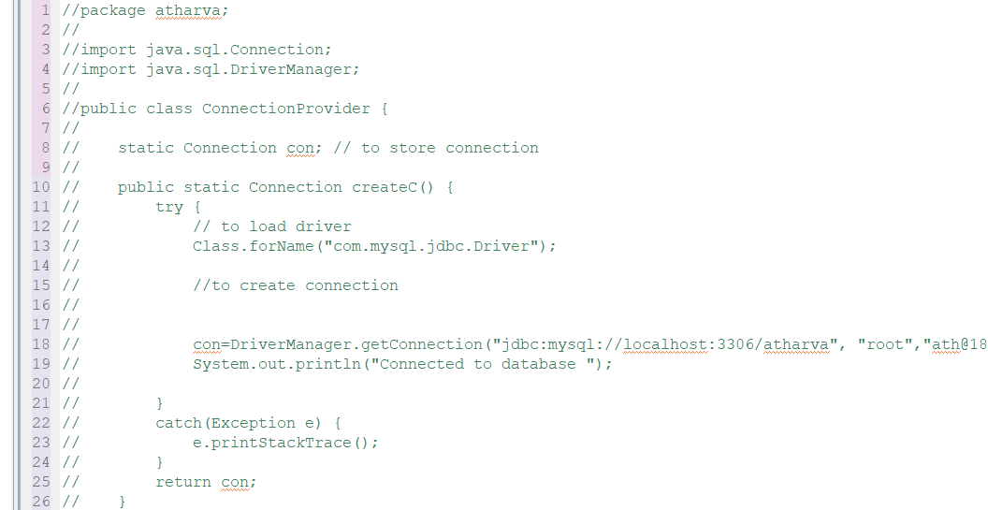
CODE SNIPPETS JDBC CONNECTION PART

Slide 7
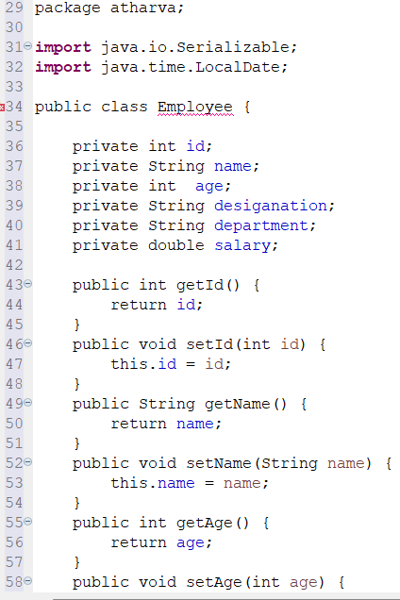
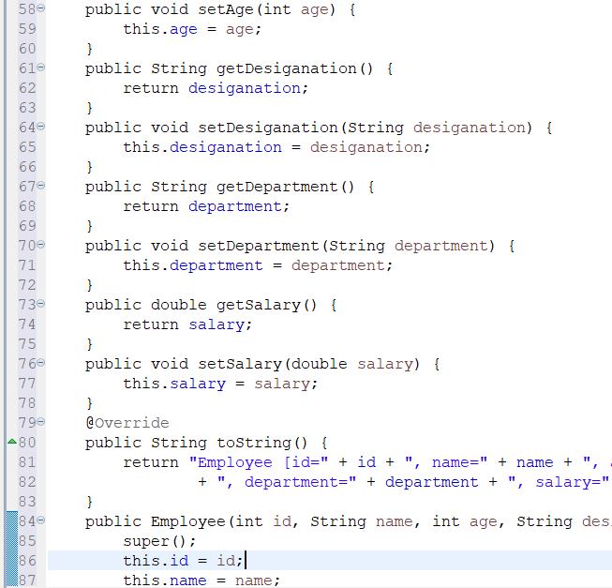
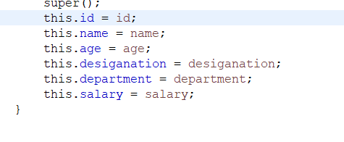
CODE SNIPPETS .JAVA PART

Slide 8
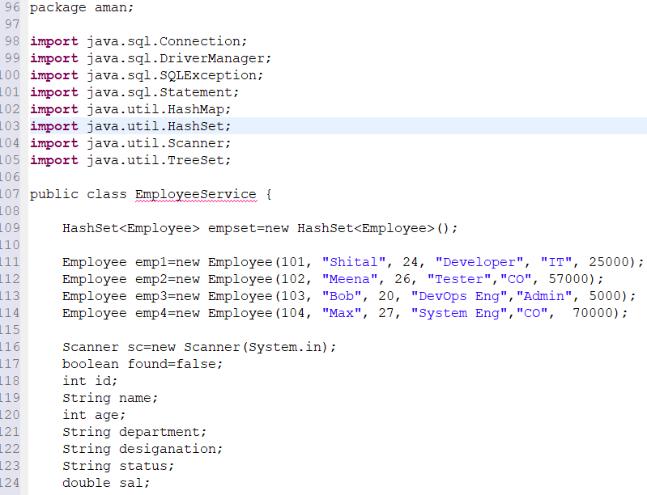
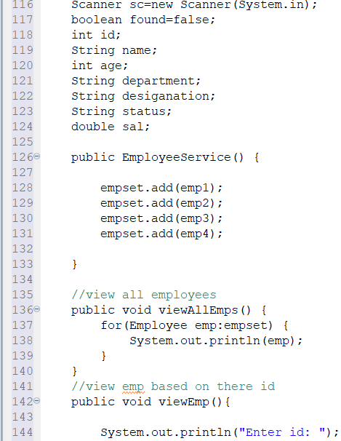
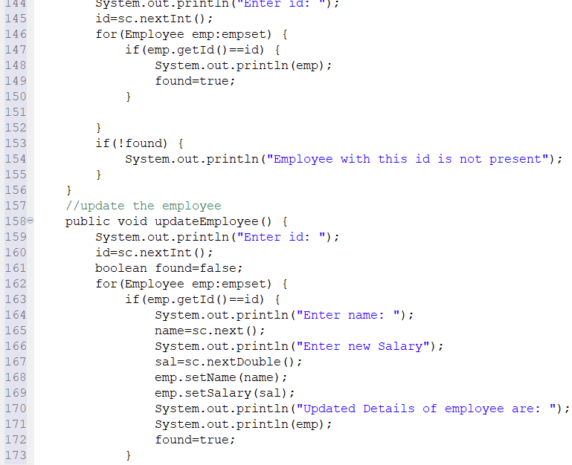
CODE SNIPPETS EMPLOYEE SERVICE PART

Slide 9
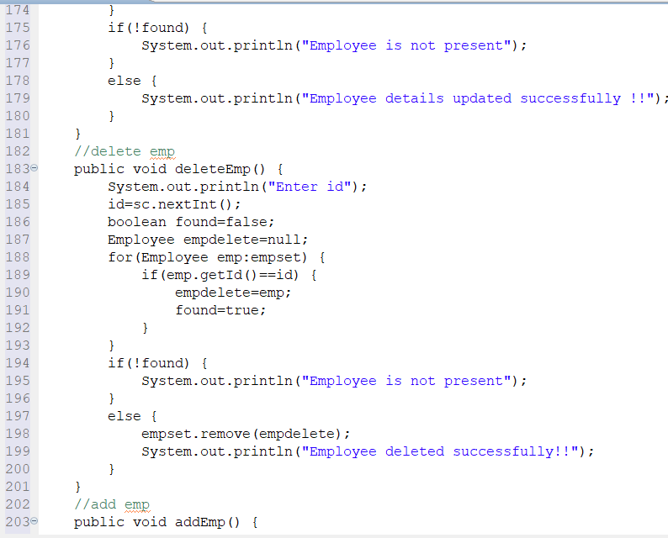
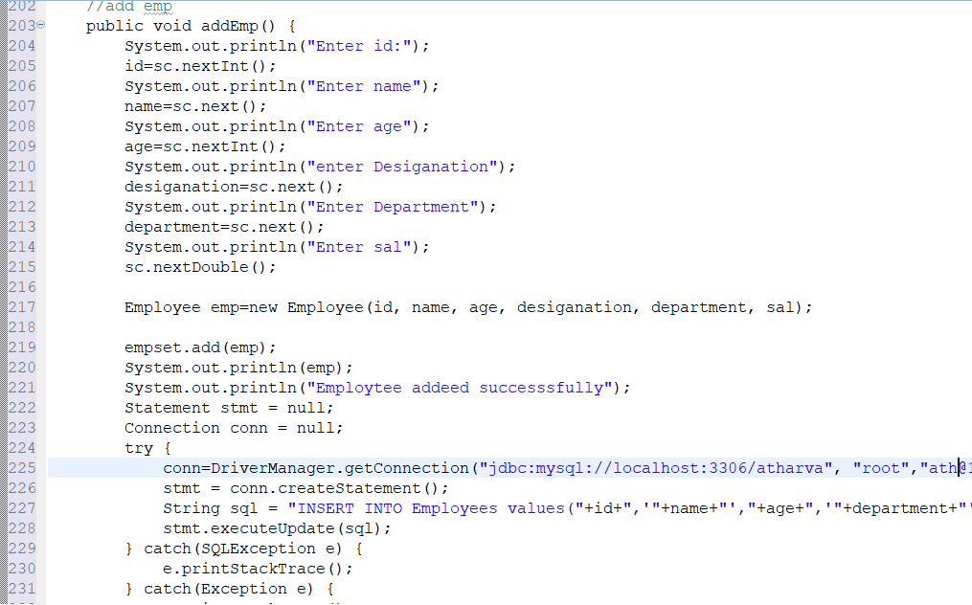
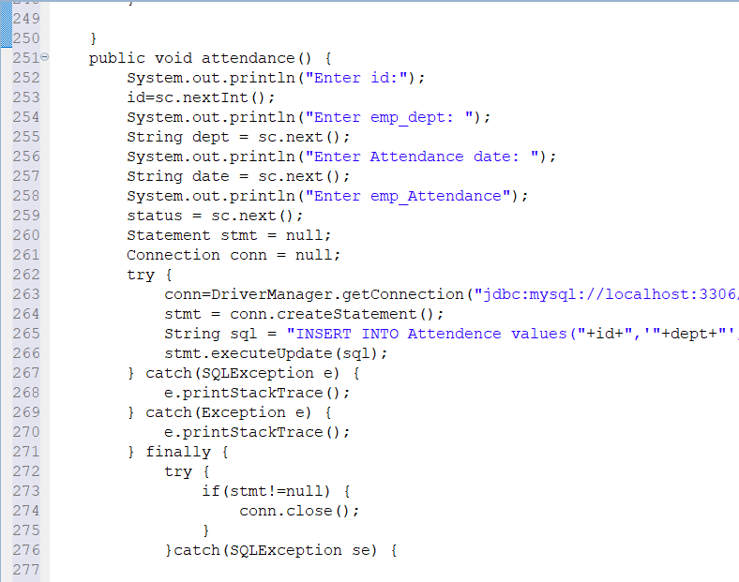
CODE SNIPPETS EMPLOYEE SERVICE PART

Slide 10
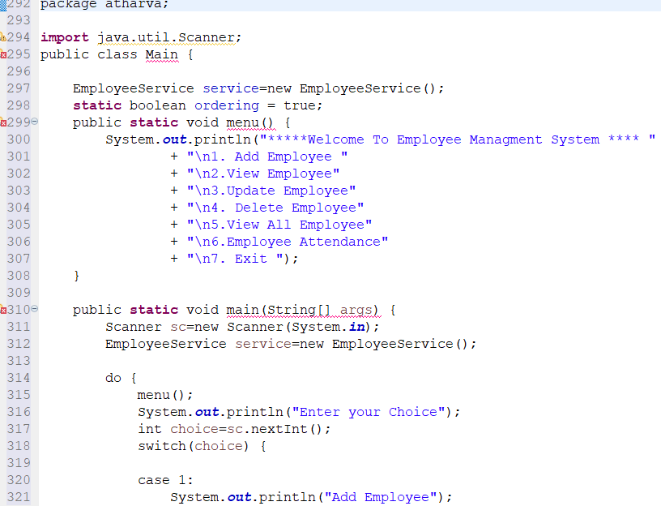
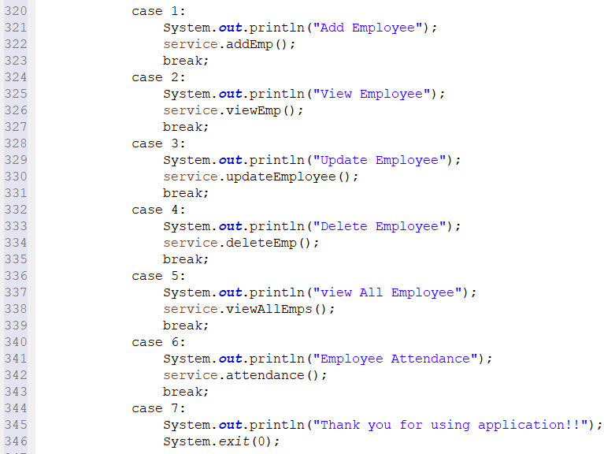
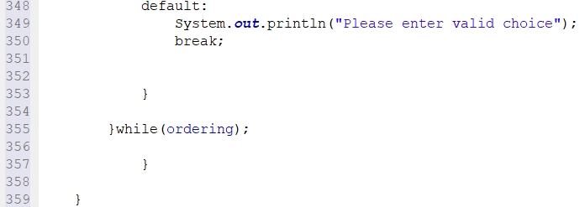
CODE SNIPPETS MAIN JAVA FILE

Slide 11
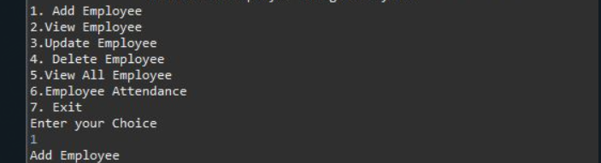
OUTPUT SCREEN-SHOTS

Slide 12
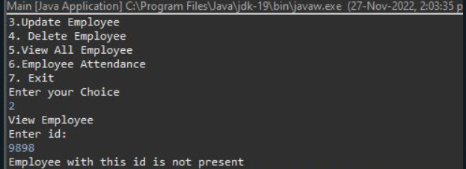
OUTPUT SCREEN-SHOTS

Slide 13

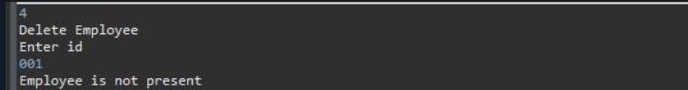
OUTPUT SCREEN-SHOTS

Slide 14
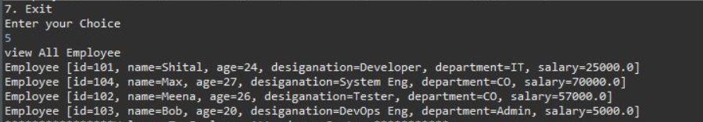
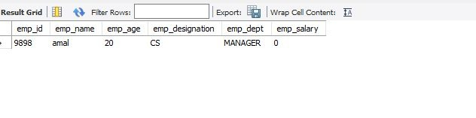
OUTPUT SCREEN-SHOTS

Slide 15
CONCLUSION
Hence we successfully build and executed our project titled “HUMAN RESOURCE MANAGEMENT SYSTEM”
We hope that in future more ,advanced and efficient technologies might come which can further reduce the workload of the stakeholders and help them to accomplish their goals respectively.

Slide 16
BIBLIOGRAPHY (REFERENCES)
CLASSROOM TEACHINGS BY IBM & UNIVERSITY FACULTIES
IBM MATERIALS UPLOADED BY IBM FACULTY
YOUTUBE
SOME HELP FROM GOOGLE (SEARCH ENGINE)

Slide 17


